Slide 1
“Develop a 2D occupancy Grid Map of a Room using Overhead Cameras”
Name: Sapnali patil

Slide 2
Contents
Introduction
System Setup
Constants and Initialization
Capturing and Processing Frame
Visualizing the occupancy grid
Displaying Result
Results
Conclusion

Slide 3
Introduction
Objective: implement real-time occupancy grid mapping using a camera and image processing.
Purpose: identify and differentiate between occupied and free spaces within a defined area to assist in navigation and spatial understanding.
Robotics: Enable robots to understand and navigate their environment safely.
Autonomous Vehicle : Assists in path planning and obstacle avoidance.
Navigation Systems : Provides accurate mapping for indoor and outdoor navigation.

Slide 4
System setup
Hardware Setup:-
Camera for capturing frames
Computer with python environment
Software Tools:-
Python: programming language used for implement.
Opencv: Library for image processing tasks.
Numpy: Library for numerical operations.
Matplotlib:Library for visualizing the occupancy grid.

Slide 5
Constants and Initialization
Grid configuration:-
‘GRID_RESOLUTION = 0.1’(meters per grid cell)
Each grid cell represents a 0.1-meter square area.
‘GRID_SIZE_X = 100’(grid cells in X direction)
‘GRID_SIZE_Y = 100’(grid cells in y direction)
The grid covers a 10-meter by 10-meter area.
Data Structure: 2D array of size ‘100*100’
Initialize occupancy grid with zeros

Slide 6
Capturing and processing the frame
Intialize camera: Use ‘cv2.VideoCapture(0)’ to access the default cameras.
Check camera status: verify that the camera opened successfully.
Capture frame: Use ‘cap.read( )’ to capture a single frame from the camera.
Process the frame: if the frame is captured successfully, pass it to the processing function for occupancy grid mapping.

Slide 7
Visualizing the occupancy grid map
1.Displaying the Occupancy Grid:
plt.imshow(occupancy_grid, cmap='gray', origin='lower’)
2. Adding a Colorbar:
plt.colorbar(label='Occupancy’)
3. Setting Titles and Labels:
plt.title('Occupancy Grid Map')
plt.xlabel('Grid cells (X direction)')
plt.ylabel('Grid cells (Y direction)’)
4. Displaying the Grid:
plt.grid(True)
5. Updating the Plot in Real-Time:
plt.pause(0.001)

Slide 8
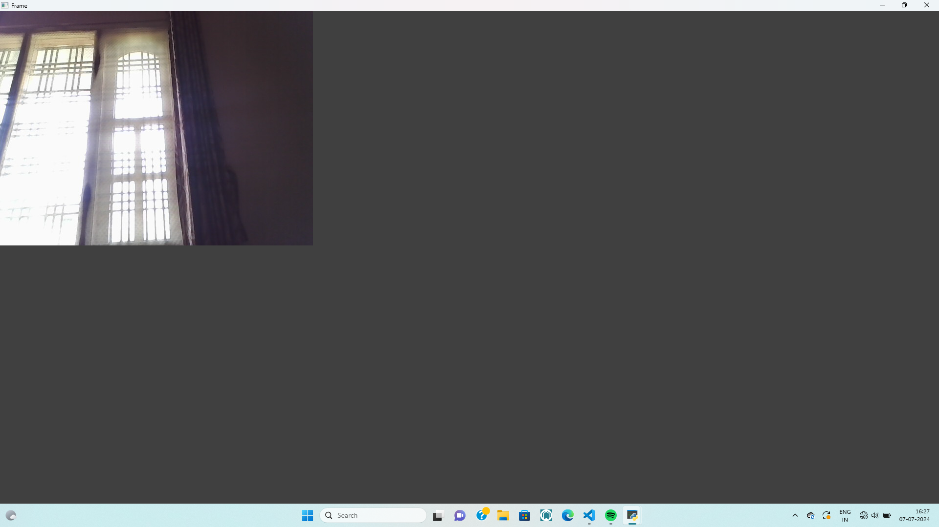
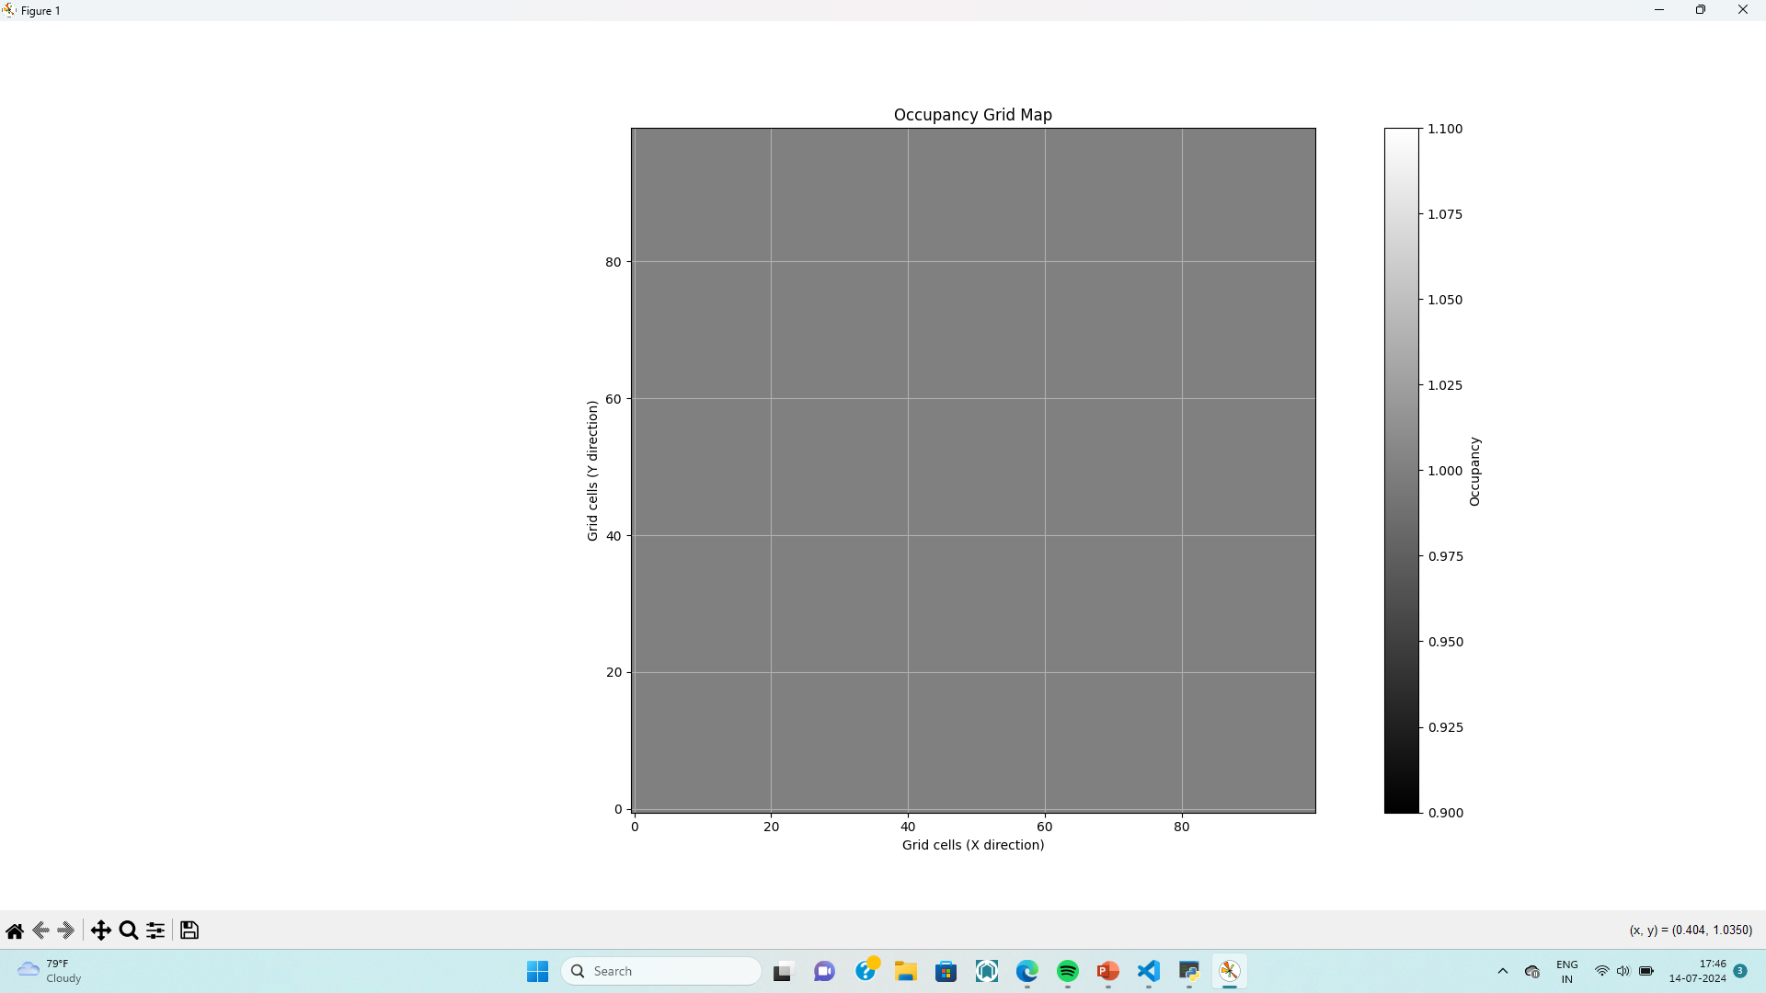
Displaying result
Capturing the image: Mapping the Grid:

Slide 9
Result
Description: The occupancy grid map is updated in real-time based on the camera feed.
The grid map displays occupied (white) and free (black) cells.It provides a visual representation of the spatial occupancy.
Visualizing the Occupancy Grid:
The grid map is visualized using Matplotlib with the following features:
Grayscale Color Map: To distinguish between occupied and free cells.
Color Bar: Indicates the occupancy status.
Grid Lines: Helps to identify individual cells.
Axis Labels and Title: Provides context to the visualization.

Slide 10
Conclusion
Real-Time Processing: Successfully implemented real-time processing of video feed to update the occupancy grid.
Effective Visualization: Utilized Matplotlib for clear and informative visualization of the occupancy grid.
Simplicity and Efficiency: The approach uses basic image processing techniques that are computationally efficient.
The occupancy grid provides a clear and immediate understanding of the environment.
It is essential for applications requiring spatial awareness, such as robotics and autonomous navigation.

